Slide 1
Wilson Disease: Clinical Features, Diagnosis, and Management
Dr. Hamidreza Mahboobi
Assistant professor, Bushehr university of medical sciences

Slide 2
Learning Objectives
At the end of this session, students should be able to:
Understand the pathophysiology and genetics of Wilson disease
Recognize the spectrum of clinical manifestations
Apply appropriate diagnostic tests and criteria
Outline treatment strategies and follow-up care

Slide 3
Opening Questions to Stimulate Thought
“What is the most common age group for Wilson disease presentation?”
“Which organs are primarily involved in Wilson disease?”
“What laboratory test is most reliable for diagnosing Wilson disease?”
“How do you differentiate Wilson disease from autoimmune hepatitis or hemochromatosis?”
“Should family members of a Wilson patient be screened?”

Slide 4
ATP7B Gene and Copper Metabolism
Autosomal recessive mutation in ATP7B
Defective incorporation of copper into ceruloplasmin
Impaired biliary copper excretion → accumulation in liver, brain, cornea

Slide 5
Copper Metabolism Overview
Dietary copper absorbed in small intestine → bound to albumin → transported to liver
Normal: Copper excreted via bile
In Wilson: Free copper accumulates → oxidative damage

Slide 6
Epidemiology
Prevalence: 1 in 30,000
Carrier frequency: ~1 in 90
Age of onset: 5–35 years (but variable)
High penetrance in younger individuals
No gender predilection

Slide 7
Organ System Involvement (Hepatic)
Asymptomatic transaminase elevation
Acute hepatitis, chronic hepatitis
Fulminant hepatic failure (especially with Coombs-negative hemolysis)
Cirrhosis

Slide 8
Neurologic
Dysarthria, dystonia, tremor, parkinsonism
Gait instability, pseudobulbar palsy

Slide 9
Psychiatric
Personality changes
Depression, psychosis
Cognitive decline

Slide 10
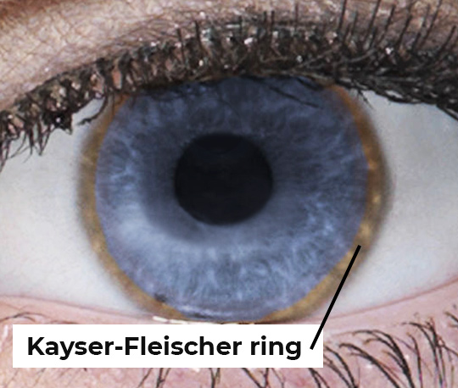
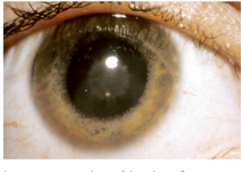
Ophthalmologic
Kayser–Fleischer rings (present in >90% with neuro signs)
Sunflower cataracts (less common)

Slide 11
Other
Hemolytic anemia
Renal tubular acidosis, nephrolithiasis
Cardiomyopathy

Slide 12
Diagnostic Criteria (Leipzig Scoring System)
Points assigned for:
Serum ceruloplasmin
24-hour urinary copper
Liver biopsy (hepatic copper >250 μg/g dry weight)
Genetic testing (ATP7B)
Kayser–Fleischer rings

Slide 13
Lab & Imaging Summary Table
Test | Expected Result in WD
Serum ceruloplasmin | ↓ <20 mg/dL
24h urine copper | ↑ >100 µg/24h
Liver enzymes | Mild ↑ AST/ALT, ALP/total bili ratio ↓
Slit-lamp exam | Kayser–Fleischer rings
MRI brain | "Face of the giant panda" sign in midbrain

Slide 14
Clinical Vignettes
Case 1: 19-year-old with fatigue, ALT 96, ceruloplasmin 10, KF rings present
Case 2: 12-year-old boy with behavioral changes and tremor, normal LFTs
Case 3: 24-year-old woman with ALF, low ceruloplasmin, hemolysis

Slide 15
Differential Diagnosis
Autoimmune hepatitis
Hemochromatosis
Alpha-1 antitrypsin deficiency
Chronic viral hepatitis
Drug-induced liver injury

Slide 16
Treatment Strategy Overview
Copper chelators:
D-penicillamine (first-line, but many side effects)
Trientine (preferred in penicillamine-intolerant patients)
Zinc salts:
Blocks intestinal copper absorption
Used for maintenance or presymptomatic siblings
Liver transplantation:
For fulminant hepatic failure or end-stage liver disease

Slide 17
Monitoring Therapy
Serial 24h urinary copper
CBC, renal function (especially with penicillamine)
Liver function tests
Monitor neurologic and psychiatric symptoms

Slide 18
Special Considerations
Pregnancy: Continue zinc therapy if possible
Family screening: Siblings require genetic testing and/or biochemical screening

Slide 19
Summary & Take-Home Messages
Wilson disease is a treatable but potentially fatal metabolic liver disease.
Always consider in young patients with liver disease or neuropsychiatric symptoms.
Early diagnosis prevents progression and allows for excellent prognosis.
Family screening is mandatory due to autosomal recessive inheritance.

Slide 20
Red Flags
Coombs-negative hemolytic anemia + liver failure → Think Wilson
ALP/total bilirubin ratio <4 in ALF → Suggestive of Wilson disease
Symptoms in adolescence with basal ganglia signs → Suspect Wilson

