Slide 1
Acute and Chronic Pancreatitis
Dr. Hamidreza Mahboobi
Assistant professor of Gastroenterology and hepatology
Fellowship of EUS
Bushehr University of Medical Science

Slide 2
Anatomy of pancreas
Endocrine Part
Secretion of glucagon, insulin, and somatostatin.
Exocrine Part
Acinar cells: Secretion of zymogens including trypsinogen, chymotrypsinogen, pro-lipase, pro-elastase, and pro-amylase into the ducts.
Ductal cells: Secretion of water and bicarbonate to neutralize gastric contents and activate pancreatic enzymes.
The ducts merge to form a larger duct, which eventually opens into the duodenum at the ampulla of Vater.

Slide 3
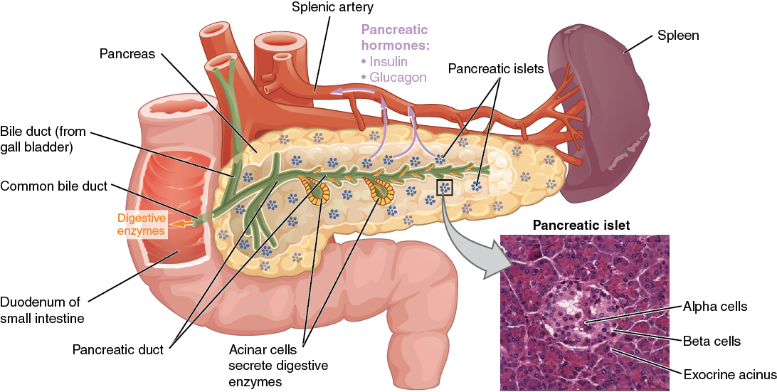

Slide 4
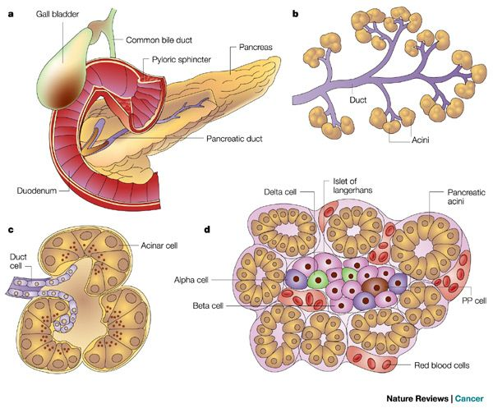

Slide 5
Acute pancreatitis
The most common disease of pancreas

Slide 6
Etiology
Biliary Stones
Most common cause (45%).
More frequent in women.
Transient elevation with ALT >150 or ALT more than 3 times the normal level.
Gallstones increase the risk of pancreatitis by 25–35 times.
Alcohol Consumption
4–5 drinks per day for more than 5 years.
Medications

Slide 7
Metabolic Disorders
DKA / Ca >12 / TG >1000
Trauma
Blunt abdominal trauma, iatrogenic (post-ERCP), sphincterotomy.
Infections
Mumps, HAV, HBV, echovirus, adenoviruses, CMV, Ascaris, Mycoplasma, Campylobacter, TB, Legionella.

Slide 8
Vasculitis
PAN, SLE.
Toxins
Snake and scorpion venom, ethanol, methanol, organophosphates.
Idiopathic
Malignancies
Smoking

Slide 9
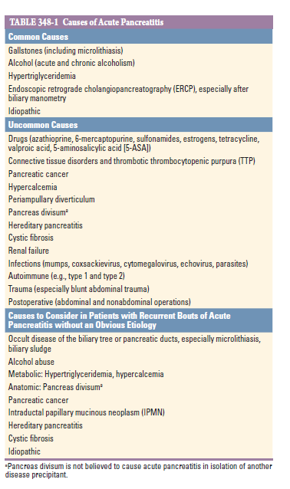

Slide 10
Drug-Induced Pancreatitis
Azathioprine, didanosine, valproic acid, 6-MP, ACE inhibitors, mesalamine, eluxadoline, tetracyclines, estrogen, metronidazole, pentamidine, furosemide, sulfonamides, methyldopa, cimetidine, ranitidine, nitrofurantoin.
Less than 5% of pancreatitis cases.
Hypersensitivity reactions: Occur 4 to 8 weeks after initiation of the drug and are not dose-dependent (most common mechanism). Upon re-exposure, pancreatitis recurs within hours to a few days.
Accumulation of toxic metabolites: Occurs several months after drug use.

Slide 11
Sign and symptoms
Persistent abdominal pain (hallmark of acute pancreatitis).
Onset is often sudden and severe / pain worsens in the supine position / pain is usually located in the upper abdomen and may radiate to the back, chest, and flanks.
Nausea and vomiting are common.
Severe tenderness in the lower abdomen sometimes associated with guarding.
Grey Turner's sign
Cullen's sign

Slide 12
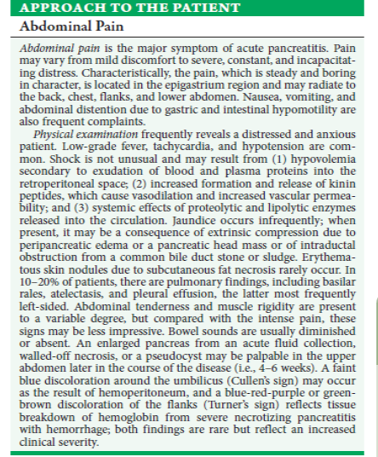

Slide 13
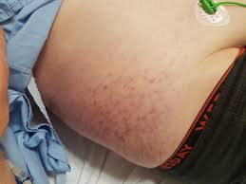
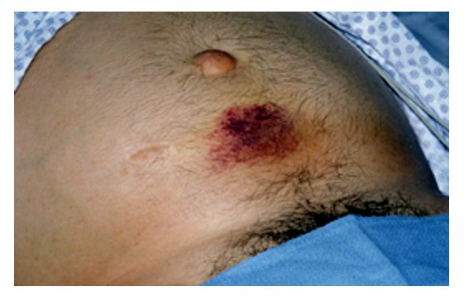

Slide 14
Diagnosis
A combination of clinical symptoms, laboratory findings, and radiologic features.
Diagnosis requires at least 2 of the following 3 characteristic findings:
Characteristic abdominal pain of acute pancreatitis,
Serum amylase or lipase (or both) at least 3 times the upper limit of normal,
Characteristic findings of acute pancreatitis on CT scan.
Metabolic manifestations are common in severe disease:
Hypocalcemia (most commonly due to hypoalbuminemia),
Hyperglycemia,
Acidosis.

Slide 15
Serum amylase may be normal in patients with hypertriglyceridemia or alcohol-induced acute pancreatitis; therefore, serum lipase is more sensitive and specific for the diagnosis of acute pancreatitis.
Serum lipase remains elevated for a longer duration than amylase, making it more useful in patients presenting several days after symptom onset.
Causes of elevated amylase:
Intestinal perforation,
Bowel obstruction,
Intestinal ischemia,
Tubo-ovarian disease,
Renal failure.

Slide 16
Pancreatic Pseudocyst
A fluid collection with a well-defined inflammatory wall, usually located outside the pancreas, without necrosis or with minimal necrosis.
Occurs at least 4 weeks after the onset of acute pancreatitis.
Most pancreatic pseudocysts are asymptomatic; when symptomatic, they may cause abdominal pain, early satiety, nausea, and vomiting due to pressure on the stomach or gastric outlet.
Rapidly enlarging pseudocysts may rupture, bleed, obstruct the extrahepatic bile ducts, invade surrounding structures, or become infected.
Asymptomatic pseudocysts should be monitored.
Drainage of pancreatic pseudocysts (endoscopic, surgical, or percutaneous):
a) Suspected infection
b) Progressive symptomatic enlargement
Endoscopic ultrasound-guided drainage into the stomach or duodenum is the preferred method.

Slide 17
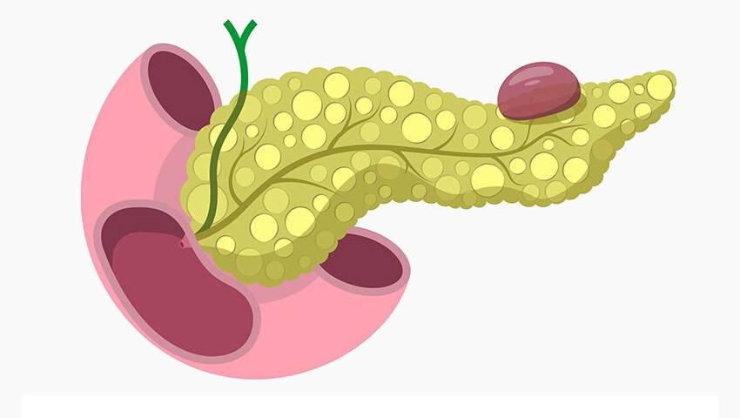
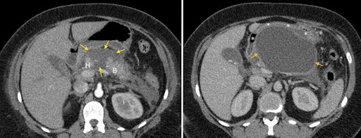

Slide 18
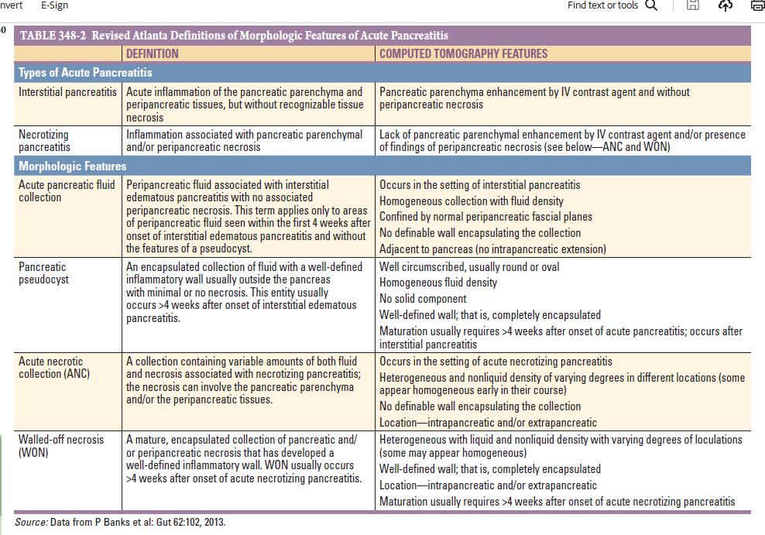

Slide 19
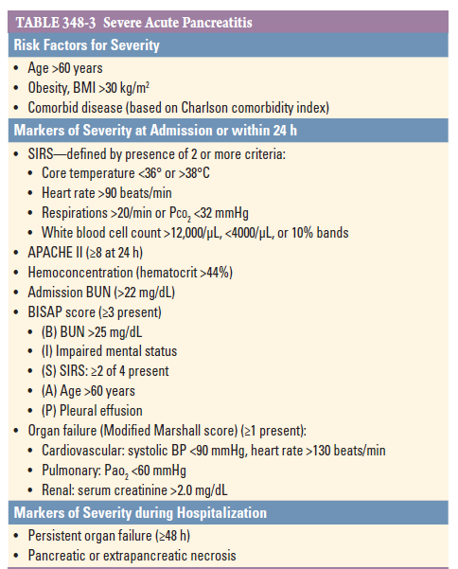

Slide 20
Imaging in Acute Pancreatitis
Indications for Contrast-Enhanced CT Scan or Pancreatic MRI:
In patients with uncertain diagnosis, especially due to excessive intestinal gas, or in those who have not improved 48–72 hours after hospitalization.
Findings may include pancreatic enlargement, peripancreatic inflammatory changes, and extrapancreatic fluid collections.
Imaging does not exclude the diagnosis of acute pancreatitis, as 15–30% of patients with mild disease may have normal findings.
Contrast-enhanced CT scan is useful for assessing the severity of pancreatitis based on the presence of pancreatic necrosis and peripancreatic fluid collections. Prior to imaging, adequate fluid resuscitation is necessary to reduce contrast toxicity.
MRI is indicated in patients with contrast allergy or in those with renal insufficiency.

Slide 21
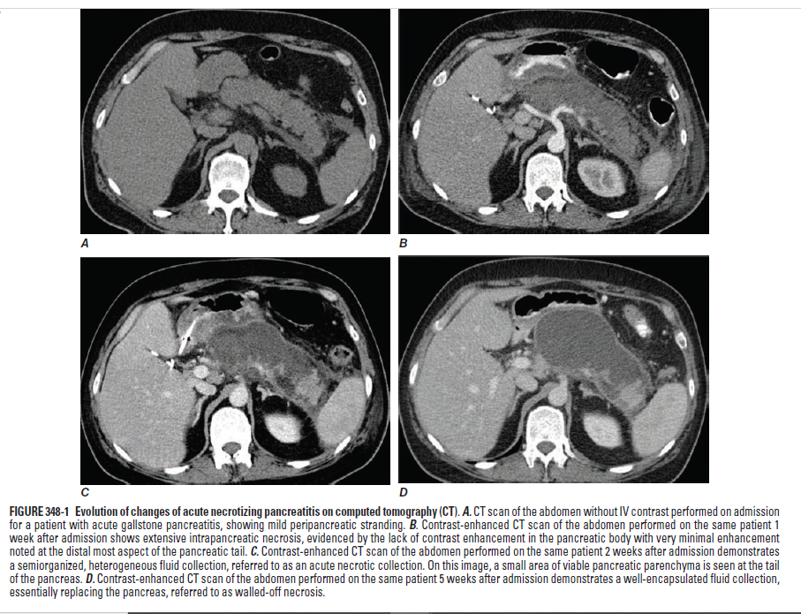

Slide 22
Prognosis
There is no correlation between the degree of serum amylase or lipase elevation and the severity of pancreatitis.
Within the first 48–72 hours of acute pancreatitis, the following findings suggest progression toward severe disease:
Rising hematocrit or BUN
Persistent SIRS despite fluid resuscitation
Organ dysfunction, including:
a) Shock: Systolic blood pressure <90 mmHg
b) Respiratory failure: PaO₂ ≤60 mmHg
c) Acute kidney injury: Creatinine >2 mg/dL after hydration

Slide 23
Treatment
ICU admission if possible.
Supportive treatments:
Aggressive intravenous hydration
Parenteral analgesics
Bowel rest
Supplemental oxygen is recommended at the start of treatment for all patients
In cases of nausea, vomiting, or ileus: placement of a NG tube

Slide 24
Drugs intended to “rest” the pancreas (somatostatin, glucagon, calcitonin, H2 blockers) and enzyme inhibitors (aprotinin and glycosylated mesylate) are not effective in reducing complications or mortality.
In sterile necrosis, antibiotics are not recommended; however, in infected necrosis, appropriate antibiotics should be initiated before confirmation of the diagnosis and continued with the selected agent once culture results are available.
Aggressive fluid therapy during the first 12–24 hours is crucial. Early aggressive hydration reduces pancreatic necrosis and organ failure. Fluid therapy after 24 hours has minimal benefit.

Slide 25
Crystalloids, especially Ringer's lactate, are initiated with a bolus dose, followed by infusion at 250–500 mL/hour or 5–10 mL/kg/hour.
Fluid administration should aim to maintain a urine output of 0.5 mL/kg/hour.
Patients receiving frequent narcotic analgesics should be monitored for oxygen saturation, as hypoxia may be missed.

Slide 26
Nutritional Support
Mild Pancreatitis
Oral feeding can be initiated within the first 24 hours without waiting for pain resolution or normalization of pancreatic enzyme levels. Starting with low-fat solid foods is as safe as clear liquids and may even reduce the length of hospital stay.
Severe Pancreatitis
Enteral nutrition via nasoenteric or nasogastric tube is preferred.
Parenteral nutrition is reserved for patients who cannot tolerate enteral absorption or for whom NG tube placement is not possible.

Slide 27
Recurrence of Gallstone-Induced Pancreatitis
The recurrence rate is 50–75% within 6 months, thus cholecystectomy is recommended.
In mild pancreatitis: before discharge
In severe pancreatitis: cholecystectomy is often delayed
Emergency ERCP is indicated to identify and remove biliary stones in patients with signs of biliary obstruction or cholangitis confirmed by imaging or laboratory tests.
In patients who are not candidates for cholecystectomy, biliary sphincterotomy without gallbladder removal may be performed.

Slide 28
Infected Pancreatic Necrosis
Fever, leukocytosis, and worsening abdominal pain.
Sometimes CT scan shows gas bubbles at the site of necrosis.
In suspected infected pancreatic necrosis, debridement should be performed even if not definitively proven.
Step-up approach:
Broad-spectrum antibiotics and percutaneous drainage if necessary.
After at least 4 weeks, minimally invasive debridement is performed if needed. At this stage, necrotic tissue has liquefied and walls have formed around the pancreas.
Drainage, debridement, or both may be performed.

Slide 29
Chronic Pancreatitis

Slide 30
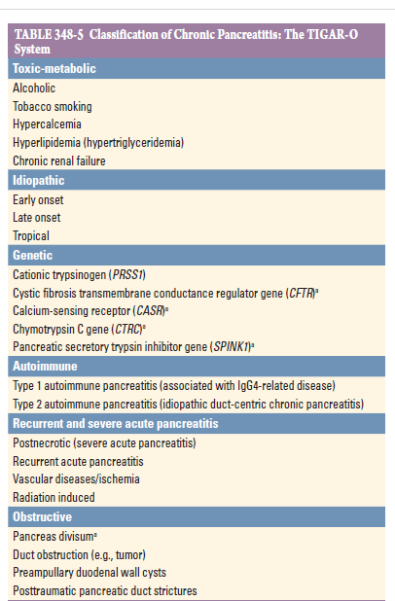

Slide 31
Clinical presentation
Pain
Episodic or persistent pain / located in the epigastrium and often radiating to the back / sometimes accompanied by nausea and vomiting / relief of pain by sitting or leaning forward / pain usually occurs 15–30 minutes after meals, initially episodic and becoming continuous as the disease progresses.
Exocrine and Endocrine Pancreatic Insufficiency
Pancreatic insufficiency does not occur until approximately 90% of pancreatic function is lost.
Steatorrhea usually precedes protein deficiency.
Abdominal bloating, malabsorption of fat-soluble vitamins and vitamin B12; therefore, periodic assessment of vitamin D levels and bone densitometry is recommended.
Marked malabsorption and weight loss.
Glucose intolerance occurs, but overt diabetes usually develops in the late stages of the disease.

Slide 32
Diagnosis
Non-Functional Tests
Fecal fat analysis, fecal elastase, and serum trypsin.
Functional tests (serum amylase and lipase) do not become abnormal until approximately 90% of pancreatic enzymes are lost; therefore, chronic pancreatitis cannot be confirmed or excluded based solely on pancreatic enzyme levels.
72-hour fecal fat test
Used to diagnose steatorrhea when fat excretion exceeds 7 g/day.
This test is neither specific nor sufficiently sensitive.
Fecal elastase measurement
The most common non-invasive and indirect test for diagnosing exocrine pancreatic insufficiency.
Fecal elastase <200 μg/g stool indicates insufficiency.
In patients with diarrhea, results may be falsely low due to stool dilution.

Slide 33
Some patients with chronic pancreatitis are asymptomatic and are diagnosed incidentally on imaging.
Pancreatic calcification on plain abdominal X-ray or CT scan is pathognomonic for chronic pancreatitis.

Slide 34
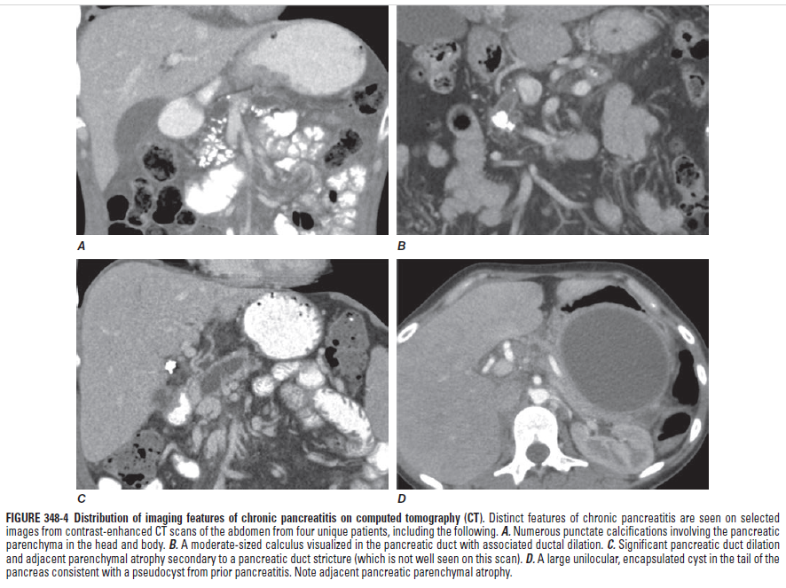

Slide 35
Endoscopic Ultrasound (EUS)
Major Criteria
A hyperechoic area with shadowing: indicative of a ductal stone
Lobulation of the pancreas with a honeycombing appearance
Minor Criteria
Cysts
Main pancreatic duct dilation ≥3.5 mm
Irregular pancreatic duct margins
Side branch dilation ≥1 mm
Hyperechoic duct wall
Parenchymal strands
A hyperechoic area without shadowing
Lobulation with irregular lobules

Slide 36
EUS plays a crucial role in the diagnosis of chronic pancreatitis.
In the absence of these criteria, chronic pancreatitis is unlikely, whereas the presence of 4 or more criteria strongly suggests chronic pancreatitis, even if other functional tests and imaging studies are normal.
ERCP should not be used for diagnosing chronic pancreatitis; MRCP is preferred.

Slide 37
Treatment
Malabsorption
Commercial pancreatin preparations contain lipase, amylase, trypsin, and chymotrypsin.
USP 40,000–50,000 units of lipase should be taken with each main meal and half this dose with snacks.
Enzyme supplements should be taken with food.
Bacterial overgrowth occurs in 25% of patients due to reduced intestinal motility from pancreatic inflammation or the use of narcotic analgesics, which may worsen steatorrhea.
Abdominal pain management
Avoid smoking and alcohol
Non-opioid analgesics, and opioids if necessary
Suppression of pancreatic secretions with oral pancreatic enzyme supplements, somatostatin analogs, and enteral nutrition
Pregabalin, TCAs, SSRIs, SNRIs
Antioxidants: selenium, vitamins C and E, methionine
Endoscopic decompression
Surgery

Slide 38
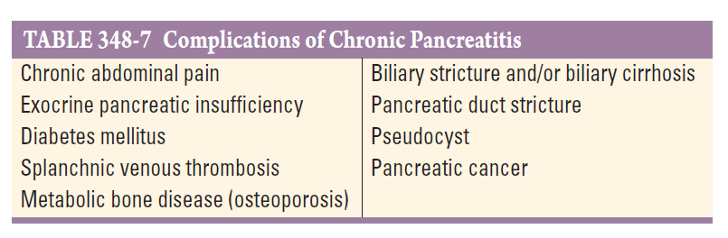

Slide 39

Thanks for attention

