Slide 1
Harrison Gastroenterology MCQ review
Dr. Hamidreza Mahboobi
Bushehr University of Medical Sciences

Slide 2
Question 1
A 59-year-old female develops acute diverticulitis and requires hospitalization for IV antibiotics. She has a CT scan that does not show evidence of abscess perforation, stricture, or fistula, and she improves in about a week. Which of the following should be undertaken to prevent further symptomatic disease?
A) Annual colonoscopy
B) Avoidance of nuts
C) Daily mesalamine therapy
D) Initiation of a high-fiber diet
E) Subtotal colectomy to reduce the risk of perforation during a subsequent bout

Slide 3
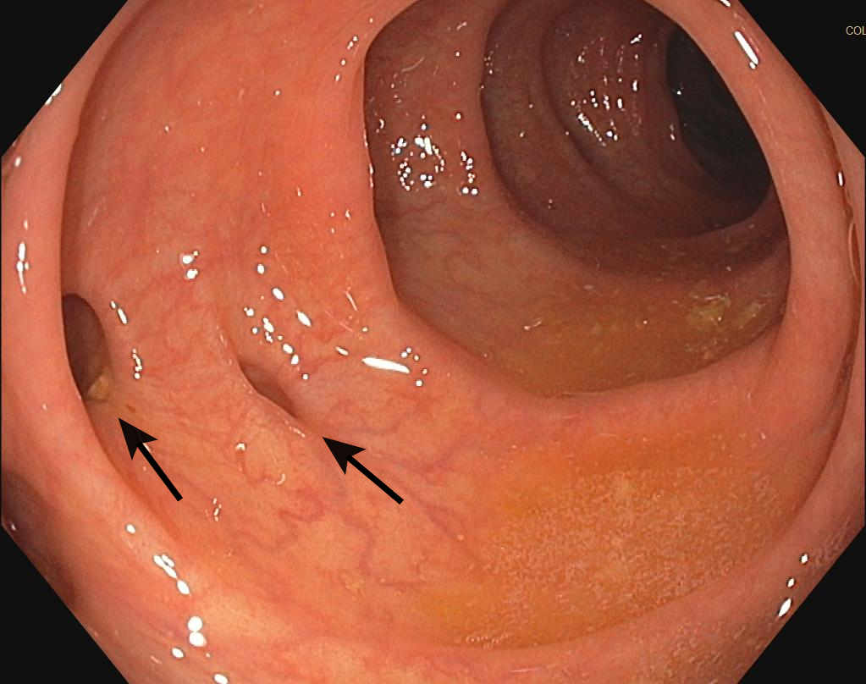

Slide 4
Answer 1
The answer is D.(Chap. 321) Patients with diverticular disease may benefit from a fiber-enriched diet that includes 30 g of fiber each day. The use of fiber decreases colonic transit time, and, therefore, prevents increased intraluminal pressure leading to the development of diverticulosis.
Diverticular disease is considered a functional bowel disorder associated with low-grade inflammation. However, the use of anti-inflammatory medications (mesalazine) in randomized clinical trials have not demonstrated any effect on recurrence rates over placebo alone.
Probiotics containing Lactobacillus acidophilus and Bifidobacterium strains may be beneficial, but they have not been definitively shown to reduce the risk of symptomatic disease.
The historical recommendation to avoid eating nuts is based on no more than anecdotal data.
Colonoscopy should be considered 6 weeks after resolution of acute diverticulitis to rule out colon cancer.
In the absence of complicated diverticular disease there is no indication for surgery following a single bout of diverticulitis. However, patients on immunosuppressive therapy, in chronic renal failure, or with a collagen-vascular disease have a fivefold greater risk of perforation during recurrent attacks. Surgical therapy is indicated in all low-surgical-risk patients with complicated diverticular disease.

Slide 5
Question 2
A 35-year-old man presents with progressive dysphagia over a 2-month period. He has noted that food has been getting stuck more frequently in the last 2 weeks. He has a history of intermittent gastroesophageal reflux disease for which he takes over-the-counter antacids every few weeks. He has a history of eczema as a child but is not currently requiring treatment. He undergoes an esophagogastroduodenoscopy, which is shown in Figure VII-14A.

Slide 6
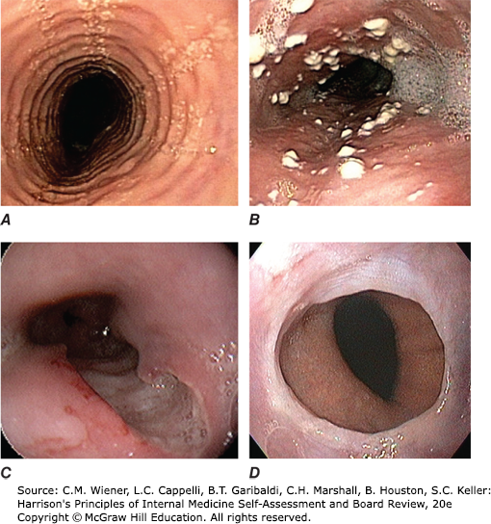

Slide 7
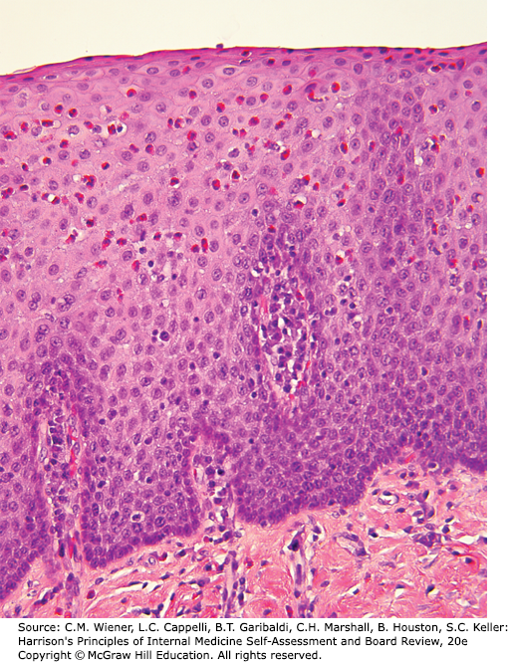
Biopsy

Slide 8
Which of the following is the most appropriate first step in management?
A) Elimination diet
B) IV methylprednisolone
C)Mepolizumab
D)Trial of a proton pump inhibitor
E)Topical corticosteroids

Slide 9
Answer 2
The answer is D.(Chap. 316) This person has eosinophilic esophagitis (EoE) as evidenced by his symptoms, esophagogastroduodenoscopy appearance, and pathologic findings. The biopsy shows infiltration of the esophageal squamous epithelium with eosinophils, with basal cell hyperplasia, and lamina propria fibrosis. EoE characteristically exhibits multiple esophageal rings, linear furrows, white punctate exudate, and strictures on endoscopy.
A trial of a proton pump inhibitor (PPI) leads to the resolution of eosinophilic esophagitis in about 30–50% of cases. If a PPI trial does not work, patients are often encouraged to start an elimination diet to try to avoid common food allergens that might be causative. Swallowed topical corticosteroids are effective but esophagitis often recurs on cessation of the topical steroid. Systemic corticosteroids are only used if all other treatment options fail. The role of newer anti–interleukin-5 therapies such as mepolizumab in treating eosinophilic esophagitis is not yet known.

Slide 10
Question 3
A 51-year-old alcoholic man presents to the emergency department complaining of vomiting blood. On further evaluation including gastric lavage, you determine that he is not experiencing an upper gastrointestinal bleed, but he is having significant gingival bleeding. He is intoxicated and complains of fatigue. Reviewing his chart, you find that he had a hemarthrosis evacuated 6 months ago and has been lost to follow-up since then. He takes no medications. Laboratory data show platelets of 250,000 and international normalized ratio of 0.9. He has a diffuse hemorrhagic eruption on his legs that is centered around hair follicles. Which of the following is the recommended treatment for this patient’s underlying disorder?
A) Folate
B) Niacin
C) Thiamine
D) Vitamin C
E) Vitamin K

Slide 11
Answer 3
The answer is D.(Chap. 326) This patient presents with gingival bleeding and has the classic perifollicular hemorrhagic rash of scurvy (vitamin C deficiency). In the United States, scurvy is primarily a disease of alcoholics and the elderly who consume <10 mg/d of vitamin C. Other individuals who are at risk of the disease are the poor and those who consume macrobiotic diets that are high in grains and seafood but avoid citrus fruits. In addition to nonspecific symptoms of fatigue, these patients also have impaired ability to form mature connective tissue and can bleed into various sites, including the joints, skin, and gingiva. A normal international normalized ratio excludes symptomatic vitamin K deficiency. Thiamine, niacin, and folate deficiencies are also seen in patients with alcoholism. Thiamine deficiency may cause peripheral neuropathy (beriberi), high-output heart failure, ataxia, and memory impairment. Folate deficiency causes macrocytic anemia and thrombocytopenia. Niacin deficiency causes pellagra, which is characterized by glossitis and a pigmented, scaling rash that may be particularly noticeable in sun-exposed areas.

Slide 12
Question 4
Which of the following statements regarding the signs and symptoms of a patient with acute appendicitis is true?
A) Anorexia is an uncommon symptom.
B) McBurney point describes pain in the mid-epigastrium.
C) Patients with pelvic appendicitis commonly present with dysuria, urinary frequency, diarrhea, or tenesmus.
D) Right lower quadrant tenderness is present in only 50% of patients.
E)Rovsing sign is the most sensitive finding on physical examination.

Slide 13
Answer 4
The answer is C.(Chap. 324) Arriving at the diagnosis of appendicitis can be challenging when the appendix is not located in the right lower quadrant, in women of childbearing age, and in the very young or elderly. Patients with pelvic appendicitis commonly present with dysuria, urinary frequency, diarrhea, or tenesmus. For this reason a pelvic and rectal examination should be performed in patients with suspected appendicitis. Anorexia is such a common symptom in appendicitis that its absence should prompt a search for an alternative diagnosis. Classically, maximal tenderness is identified in the right lower quadrant at or near McBurney point, which is located approximately one-third of the way along a line originating at the anterior iliac spine and running to the umbilicus. Right lower quadrant tenderness is present in over 90% of patients with appendicitis, while Rovsing sign, which is pain in the right lower quadrant during left lower quadrant palpation, is only present in 5% of patients with acute appendicitis (Table VII-47).

Slide 14
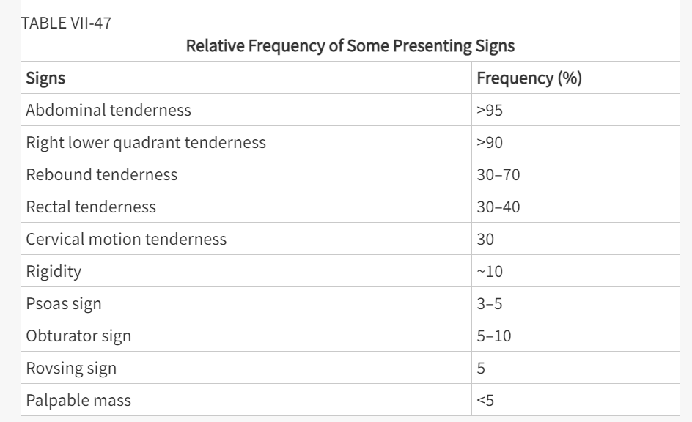

Slide 15
Question 5
Which of the following statements regarding drug-induced liver injury is true?
A) Amiodarone-induced liver injury resolves within days of stopping the drug.
B) Phenytoin-induced liver injury is only rarely accompanied by systemic symptoms and is usually picked up on screening liver enzyme testing.
C) Sodium valproate liver toxicity is more common in patients with mitochondrial deficiencies and can be ameliorated by the administration of IV carnitine.
D) The incidence of amoxicillin-induced liver injury is decreased when administered in combination with clavulanate.
E) When it occurs, nitrofurantoin liver toxicity happens soon after the initiation of the drug.

Slide 16
Answer 5
The answer is C.(Chap. 333) Valproate hepatotoxicity is more common in persons with mitochondrial enzyme deficiencies and may be ameliorated by IV administration of carnitine, which valproate therapy can deplete. Amiodarone liver toxicity can persist for a prolonged period after discontinuation of the drug because of the drug’s extremely long half-life. In many patients, hepatic injury from phenytoin is associated with striking fever, lymphadenopathy, rash (Stevens-Johnson syndrome or exfoliative dermatitis), leukocytosis, and eosinophilia, suggesting an immunologically mediated hypersensitivity mechanism. Amoxicillin liver injury is potentiated in the setting of clavulanate for reasons that are unknown. Nitrofurantoin may have a longer latency period to onset of liver injury, in part because of its intermittent and recurrent use.

Slide 17
Question 6
A 45-year-old man with ulcerative colitis has been treated for the last 5 years with infliximab with excellent resolution of his bowel symptoms and endoscopic evidence of normal colonic mucosa. He is otherwise healthy. He is evaluated by a dermatologist for a lesion that initially was a pustule over his right lower extremity but has since progressed in size with ulceration. The ulcer is moderately painful. He does not recall any trauma to the area. On examination, the ulcer measures 15 × 7 cm, and central necrosis is present. The edges of the ulcer are violaceous. No other lesions are identified. Which of the following is the most likely diagnosis?
A) Erythema nodosum
B) Metastatic Crohn disease
C) Psoriasis
D) Pyoderma gangrenosum
E) Pyoderma vegetans

Slide 18
Answer 6
The answer is D.(Chap. 319) There are a number of dermatologic manifestations of inflammatory bowel disease (IBD), and each type of IBD has a particular predilection for different dermatologic conditions. This patient has pyoderma gangrenosum. Pyoderma gangrenosum can occur in up to 12% of patients with ulcerative colitis and is characterized by a lesion that begins as a pustule and progresses concentrically to surrounding normal skin. The lesions ulcerate with violaceous, heaped margins and surrounding erythema. They are typically found on the lower extremities. Often the lesions are difficult to treat and respond poorly to colectomy; similarly, pyoderma gangrenosum is not prevented by colectomy. Treatment commonly includes IV antibiotics, glucocorticoids, dapsone, infliximab, and other immunomodulatory agents. Erythema nodosum is more common in Crohn disease and attacks correlate with bowel symptoms. The lesions are typically multiple, red hot, tender nodules measuring 1–5 cm and are found on the lower legs and arms. Psoriasis is more common in ulcerative colitis. Finally, pyoderma vegetans is a rare disorder in intertriginous areas reported to be manifestation of IBD in the skin.

Slide 19
Question 7
A 29-year-old woman comes to see you in the clinic because of abdominal discomfort. She feels abdominal discomfort on most days of the week, and the pain varies in location and intensity. She notes constipation as well as diarrhea, but diarrhea predominates. Compared with 6 months ago, she has more bloating and flatulence than she has had before. She identifies eating and stress as aggravating factors, and her pain is relieved by defecation. You suspect irritable bowel syndrome. Laboratory data include white blood cell count 8000/μL, hematocrit 32%, platelets 210,000/μL, and erythrocyte sedimentation rate 44 mm/h. Stool studies show the presence of lactoferrin but no blood. Which of the following interventions is most appropriate at this time?
A) Antidepressants
B) Ciprofloxacin
C) Colonoscopy
D) Reassurance and patient counseling
E) Stool bulking agents

Slide 20
Answer 7
The answer is D.(Chap. 320) Up to 80% of patients with irritable bowel syndrome (IBS) also have abnormal psychiatric features; however, no single psychiatric diagnosis predominates. The mechanism is not well understood but may involve altered pain thresholds. Although these patients are hypersensitive to colonic stimuli, this does not carry over to the peripheral nervous system. Functional brain imaging shows disparate activation in, for example, the mid-cingulate cortex, but brain anatomy does not discriminate IBS patients from those without IBS. An association between a history of sexual abuse and IBS has been reported. There is no reported association with sexually transmitted diseases. Patients with IBS do not have an increased risk of autoimmunity.

Slide 21
Question 8
A 43-year-old man presents with 6 months of worsening dysphagia and postprandial regurgitation. He reports difficulty and pain with swallowing both liquids and solids; he has no difficulty with the initial components of swallowing but reports pain in the mid-chest region. He frequently regurgitates undigested food 20–60 minutes after eating or drinking. In the past 2 months, he has lost 15 lb. He also has had one episode of presumed pneumonia 4 months ago notable for a right lower lobe infiltrate. He has no significant past medical history, takes no medications, and does not smoke cigarettes. He works as a service representative at a major electronics store and has never left the United States. Other than signs of recent weight loss, his physical examination is unremarkable. A barium swallow is performed and shown in Figure VII-12. Which of the following is the most likely cause of his disease?

Slide 22
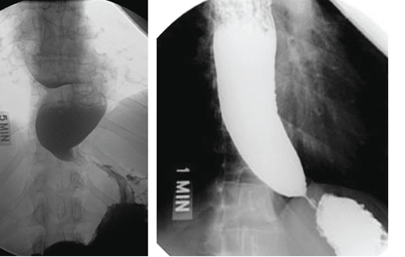

Slide 23
A) Autoimmune reaction to latent herpes virus
B) Diffuse spasm on smooth muscle
C) Infection by Trypanosoma cruzi
D) Malignant growth of columnar epithelial cells
E) Malignant growth squamous epithelial cells

Slide 24
Answer 8
The answer is A.(Chap. 316) The barium swallow image demonstrates achalasia with esophageal dilation narrowing at the gastroesophageal junction and an air-fluid level in the mid-esophagus. Achalasia is a rare disease caused by loss of ganglion cells within the esophageal myenteric plexus with a population incidence of about 1:100,000; it usually presents between age 25 and 60. With long-standing disease, aganglionosis is noted. The disease involves both excitatory (cholinergic) and inhibitory (nitric oxide) ganglionic neurons. This leads to impaired deglutitive lower esophageal sphincter (LES) relaxation and absent peristalsis. Increasing evidence suggests that the ultimate cause of ganglion cell degeneration in achalasia is an autoimmune process attributable to a latent infection with human herpes simplex virus 1 combined with genetic susceptibility. Long-standing achalasia is characterized by progressive dilatation and sigmoid deformity of the esophagus with hypertrophy of the LES. Clinical manifestations may include dysphagia, regurgitation, chest pain, and weight loss. Most patients report solid and liquid food dysphagia. Regurgitation occurs when food, fluid, and secretions are retained in the dilated esophagus.

Slide 25
Patients with advanced achalasia are at risk for bronchitis, pneumonia, or lung abscess from chronic regurgitation and aspiration. The differential diagnosis of achalasia includes diffuse esophageal spasm, Chagas disease, and pseudo-achalasia. Chagas disease is endemic in areas of central Brazil, Venezuela, and northern Argentina and spread by the bite of the reduviid (kissing) bug that transmits the protozoan Trypanosoma cruzi. The chronic phase of the disease develops years after infection and results from destruction of autonomic ganglion cells throughout the body, including the heart, gut, urinary tract, and respiratory tract. Tumor infiltration, most commonly seen with carcinoma in the gastric fundus or distal esophagus, can mimic idiopathic achalasia. The resulting pseudo-achalasia accounts for up to 5% of suspected cases and is more likely with advanced age, abrupt onset of symptoms (<1 year), and weight loss. Hence, endoscopy is a necessary part of the evaluation of achalasia. When the clinical suspicion for pseudo-achalasia is high and endoscopy nondiagnostic, CT scanning or endoscopic ultrasound may be of value. There is no known way of preventing or reversing achalasia. Therapy is directed at reducing LES pressure so that gravity and esophageal pressurization promote esophageal emptying. Peristalsis rarely, if ever, recovers. Botulinum toxin, injected into the LES under endoscopic guidance, inhibits acetylcholine release from nerve endings and improves dysphagia in about 66% of cases for at least 6 months. The only durable therapies for achalasia are pneumatic dilatation and Heller myotomy.

Slide 26
Question 9
All of the following are potential advantages of magnetic resonance cholangiopancreatography over endoscopic retrograde cholangiopancreatography EXCEPT:
A) Faster image acquisition
B) Higher sensitivity for identifying ampullary lesions
C) No risk of ionizing radiation
D) No risk of pancreatitis
E) No need for contrast media

Slide 27
Answer 9
The answer is B.(Chap. 329) Magnetic resonance cholangiopancreatography (MRCP) and endoscopic retrograde cholangiopancreatography (ERCP) are the procedures of choice for visualization of the biliary tree. MRCP offers several advantages over ERCP: there is no need for contrast media or ionizing radiation, images can be acquired faster, the procedure is less operator dependent, and it carries no risk of pancreatitis. MRCP is superior to ultrasound and CT for detecting choledocholithiasis but is less specific. MRCP is useful in the diagnosis of bile duct obstruction and congenital biliary abnormalities, but ERCP is more valuable in evaluating ampullary lesions and primary sclerosing cholangitis. ERCP permits biopsy, direct visualization of the ampulla and common bile duct, and intraductal ultrasonography and brushings for cytological evaluation of malignancy. It also provides several therapeutic options in patients with obstructive jaundice, such as sphincterotomy, stone extraction, and placement of nasobiliary catheters and biliary stents.

Slide 28
Question 10
A 64-year-old man with known cirrhosis is admitted to the intensive care unit with a large gastrointestinal bleed and altered mental status. He is confused and unable to provide any history. His initial hemoglobin is 6.9 g/dL, and his vital signs are notable for a heart rate of 115 beats/min and a blood pressure of 90/55. In addition to fluid resuscitation including transfusion of packed red blood cells. In the patient, all of the following could be used as prophylaxis for further variceal bleeding EXCEPT:
A) Initiation of a nonselective beta blocker such as propranolol
B) Initiation of daily subcutaneous octreotide injections
C) Liver transplantation
D) Repeated variceal ligation if the initial bleed was controlled with endoscopic variceal ligation
E)Transjugular intrahepatic portosystemic shunt

Slide 29
Answer 10
The answer is B.(Chap. 337) Prevention of further or subsequent variceal bleeding can be accomplished with repeated variceal band ligation until varices are obliterated. Non-selective beta blockers, such as propranolol and nadolol, have been shown to decrease the risk of recurrent variceal bleeding and reduce mortality from a subsequent bleed. Their efficacy is lessened once the esophageal varices have been banded, but they can be useful to treat portal hypertensive gastropathy that is not directly treated with variceal ligation. A TIPS would reduce portal pressure and lead to a reduction in recurrent variceal bleeding. Transplant would likewise restore normal portal pressure and lead to resolution of existing varices. A continuous infusion of octreotide may promote splanchnic vasoconstriction and can be used to manage acute variceal bleeding. Subcutaneous octreotide is not used as a prophylactic treatment.

